Slide 1
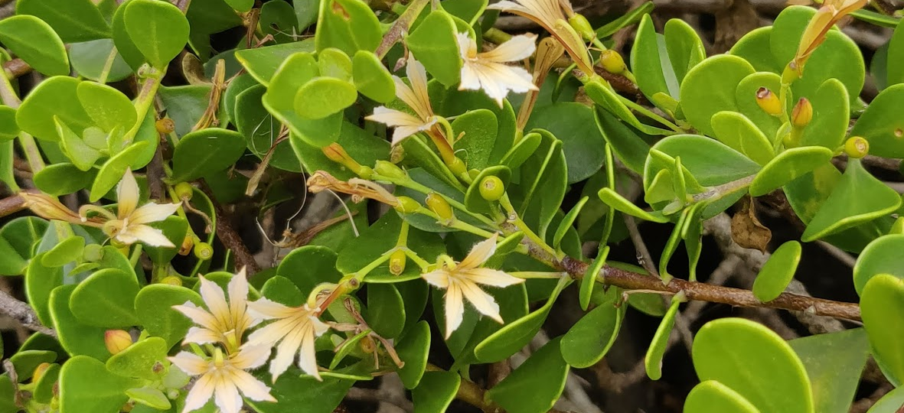
Notes:
There are several legends about the naupaka flower. The common story is of a forbidden love between a princess from up mauka and a commoner fisherman. When the priest confirmed that they cannot marry, the princess took the flower from her hair, tore it in half, and kept one half while the fisherman returned to the shoreline with the other. They planted each half, one on the shoreline and one in the mountains, watered it with their tears, and the naupaka plants grew. Each plant, the makai and the mauka ones, flower each half of the whole blossom.
Meet the Dwarf Naupaka.
This plant is a federally protected native Hawaiian species.
I was fortunate enough to meet this plant at Kalaupapa, Moloka’i.
According to sources, there are less than 300 known plants left. KNOWN being the key word.

Slide 2
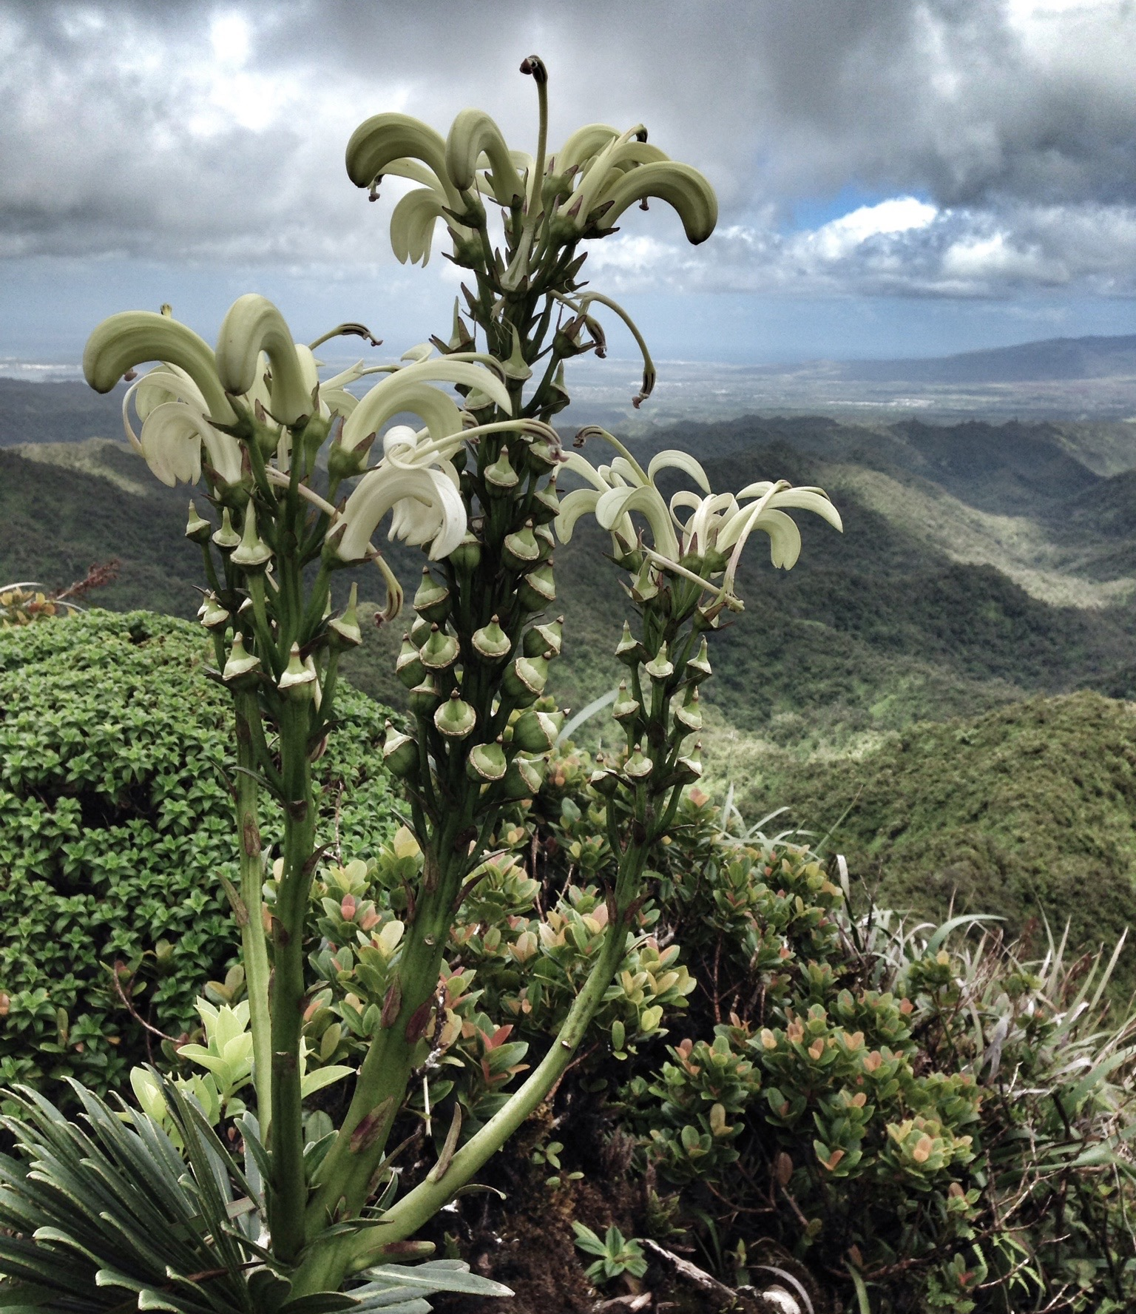
Plants - By The Numbers
1400 native plant species
90% found ONLY in Hawaiʻi
130+ plants lost to extinction
430 plants currently listed as Endangered or Threatened
Notes:
Hawaii is the endangered species capital of the world. THE WORLD!
We are home to 1400 native plant species, with 90% of that being found only here in Hawaii.
Weʻve already lost 130+ plants to extinction
430 plants are listed as Endangered or Threatened

Slide 3
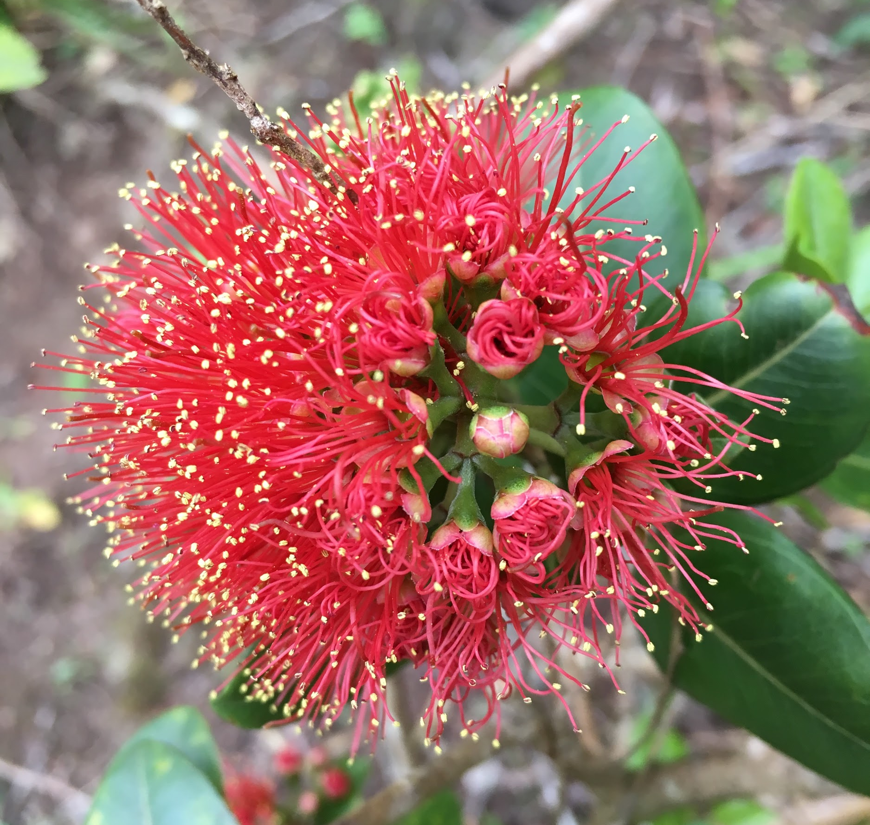
Benefits of Plant Identification
ID & locate rare / protected plants in the wild
Provide cultural context
Provide practical uses
Differentiate between invasive and natives
Notes:
Why ID plants?
If we can ID plants in the field, we can possibly locate rare or protected plants. Finding these plants, especially in the wild, gives us the ability to collect more data about flowering, germination, and even possibly collect seeds.
We can provide cultural education about plants. We can provide information on their Hawaiian names or provide stories much like the naupaka story.
Some native plants have laʻau lapaʻau or traditional Hawaiian medicinal uses.
Identifying plants allows a user to determine if the plant is a native, alien, or invasive species.

Slide 4
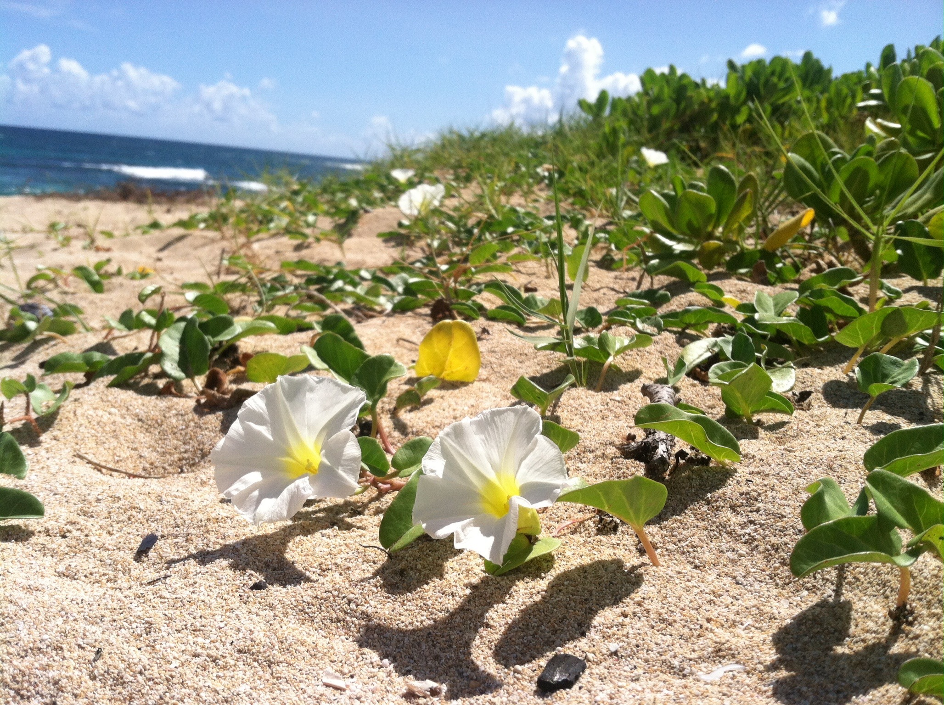
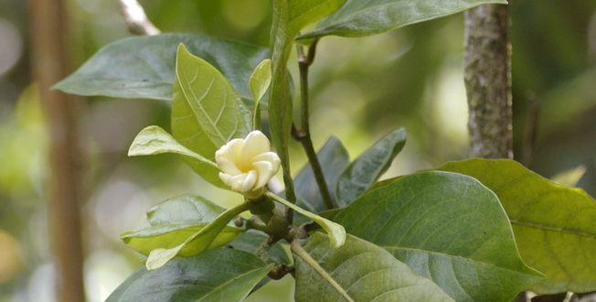
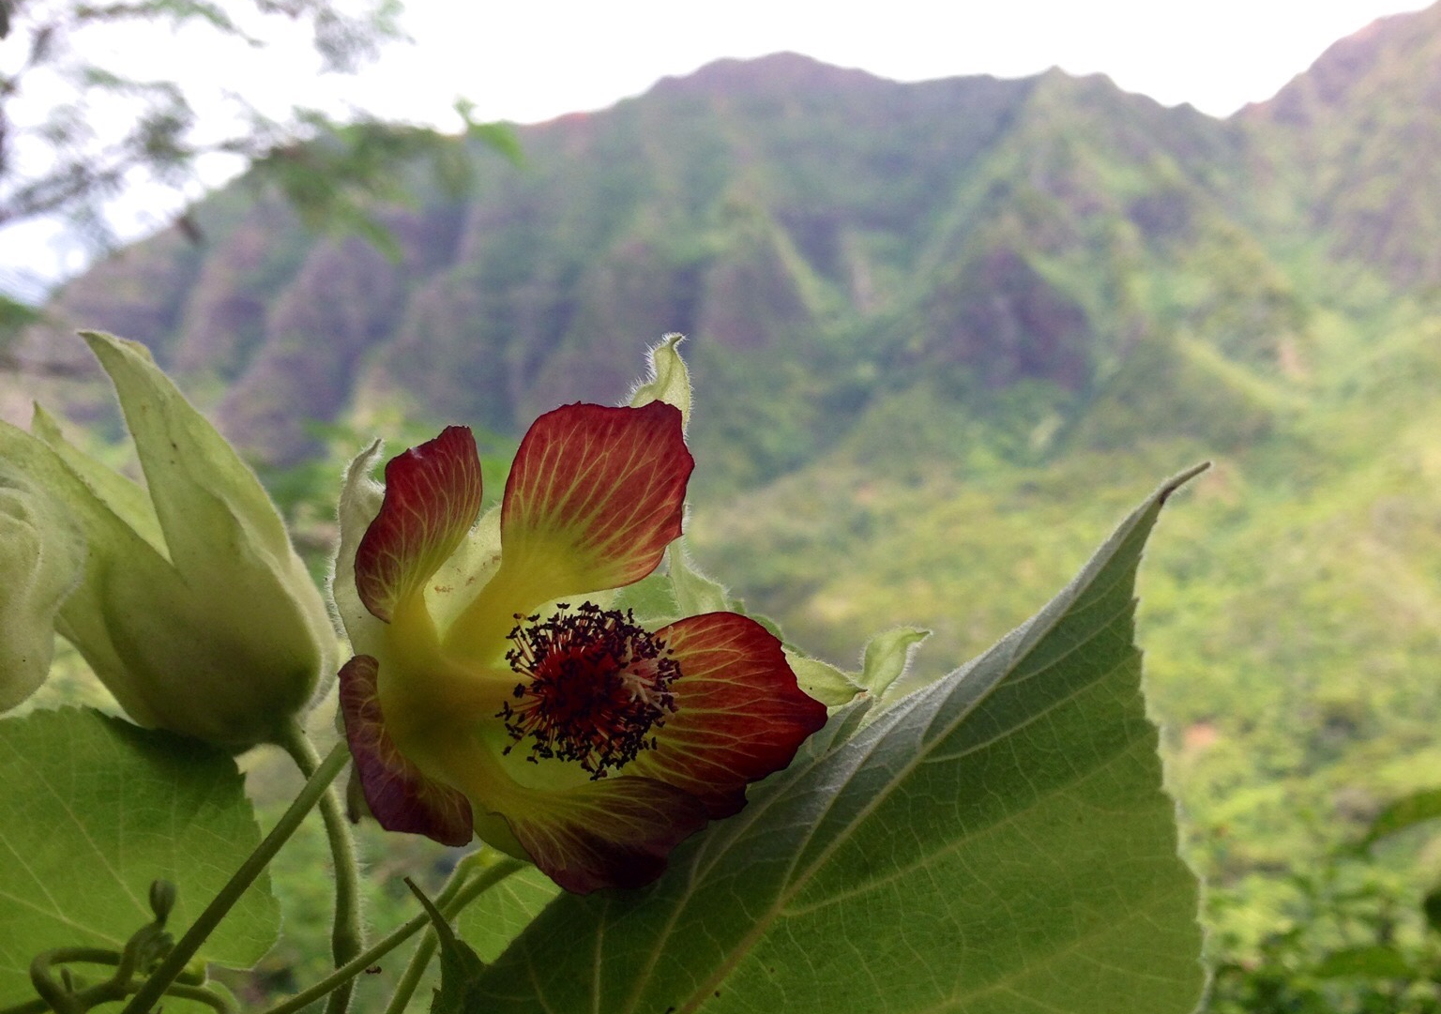
Notes:
Data sources for plant identification exist but the are mostly in textbook form.
Current data sources arenʻt easily accessible
Current data sources are quite simply boring
To be honest, I don’t know what any of these plants....but wouldn’t it be great if I had access to information about these plants readily available when I see them in the field? Information about the plants taxonomy, endangered status, cultural importance, medicinal uses, or anything else would be extremely useful when in case I’m not lugging around 5 textbooks in my backpack.
In order to protect these plants, we need to be able to identify and locate them in the wild. Only then can we gather information or seeds or other data that we might need to prevent them from going extinct.

Slide 5
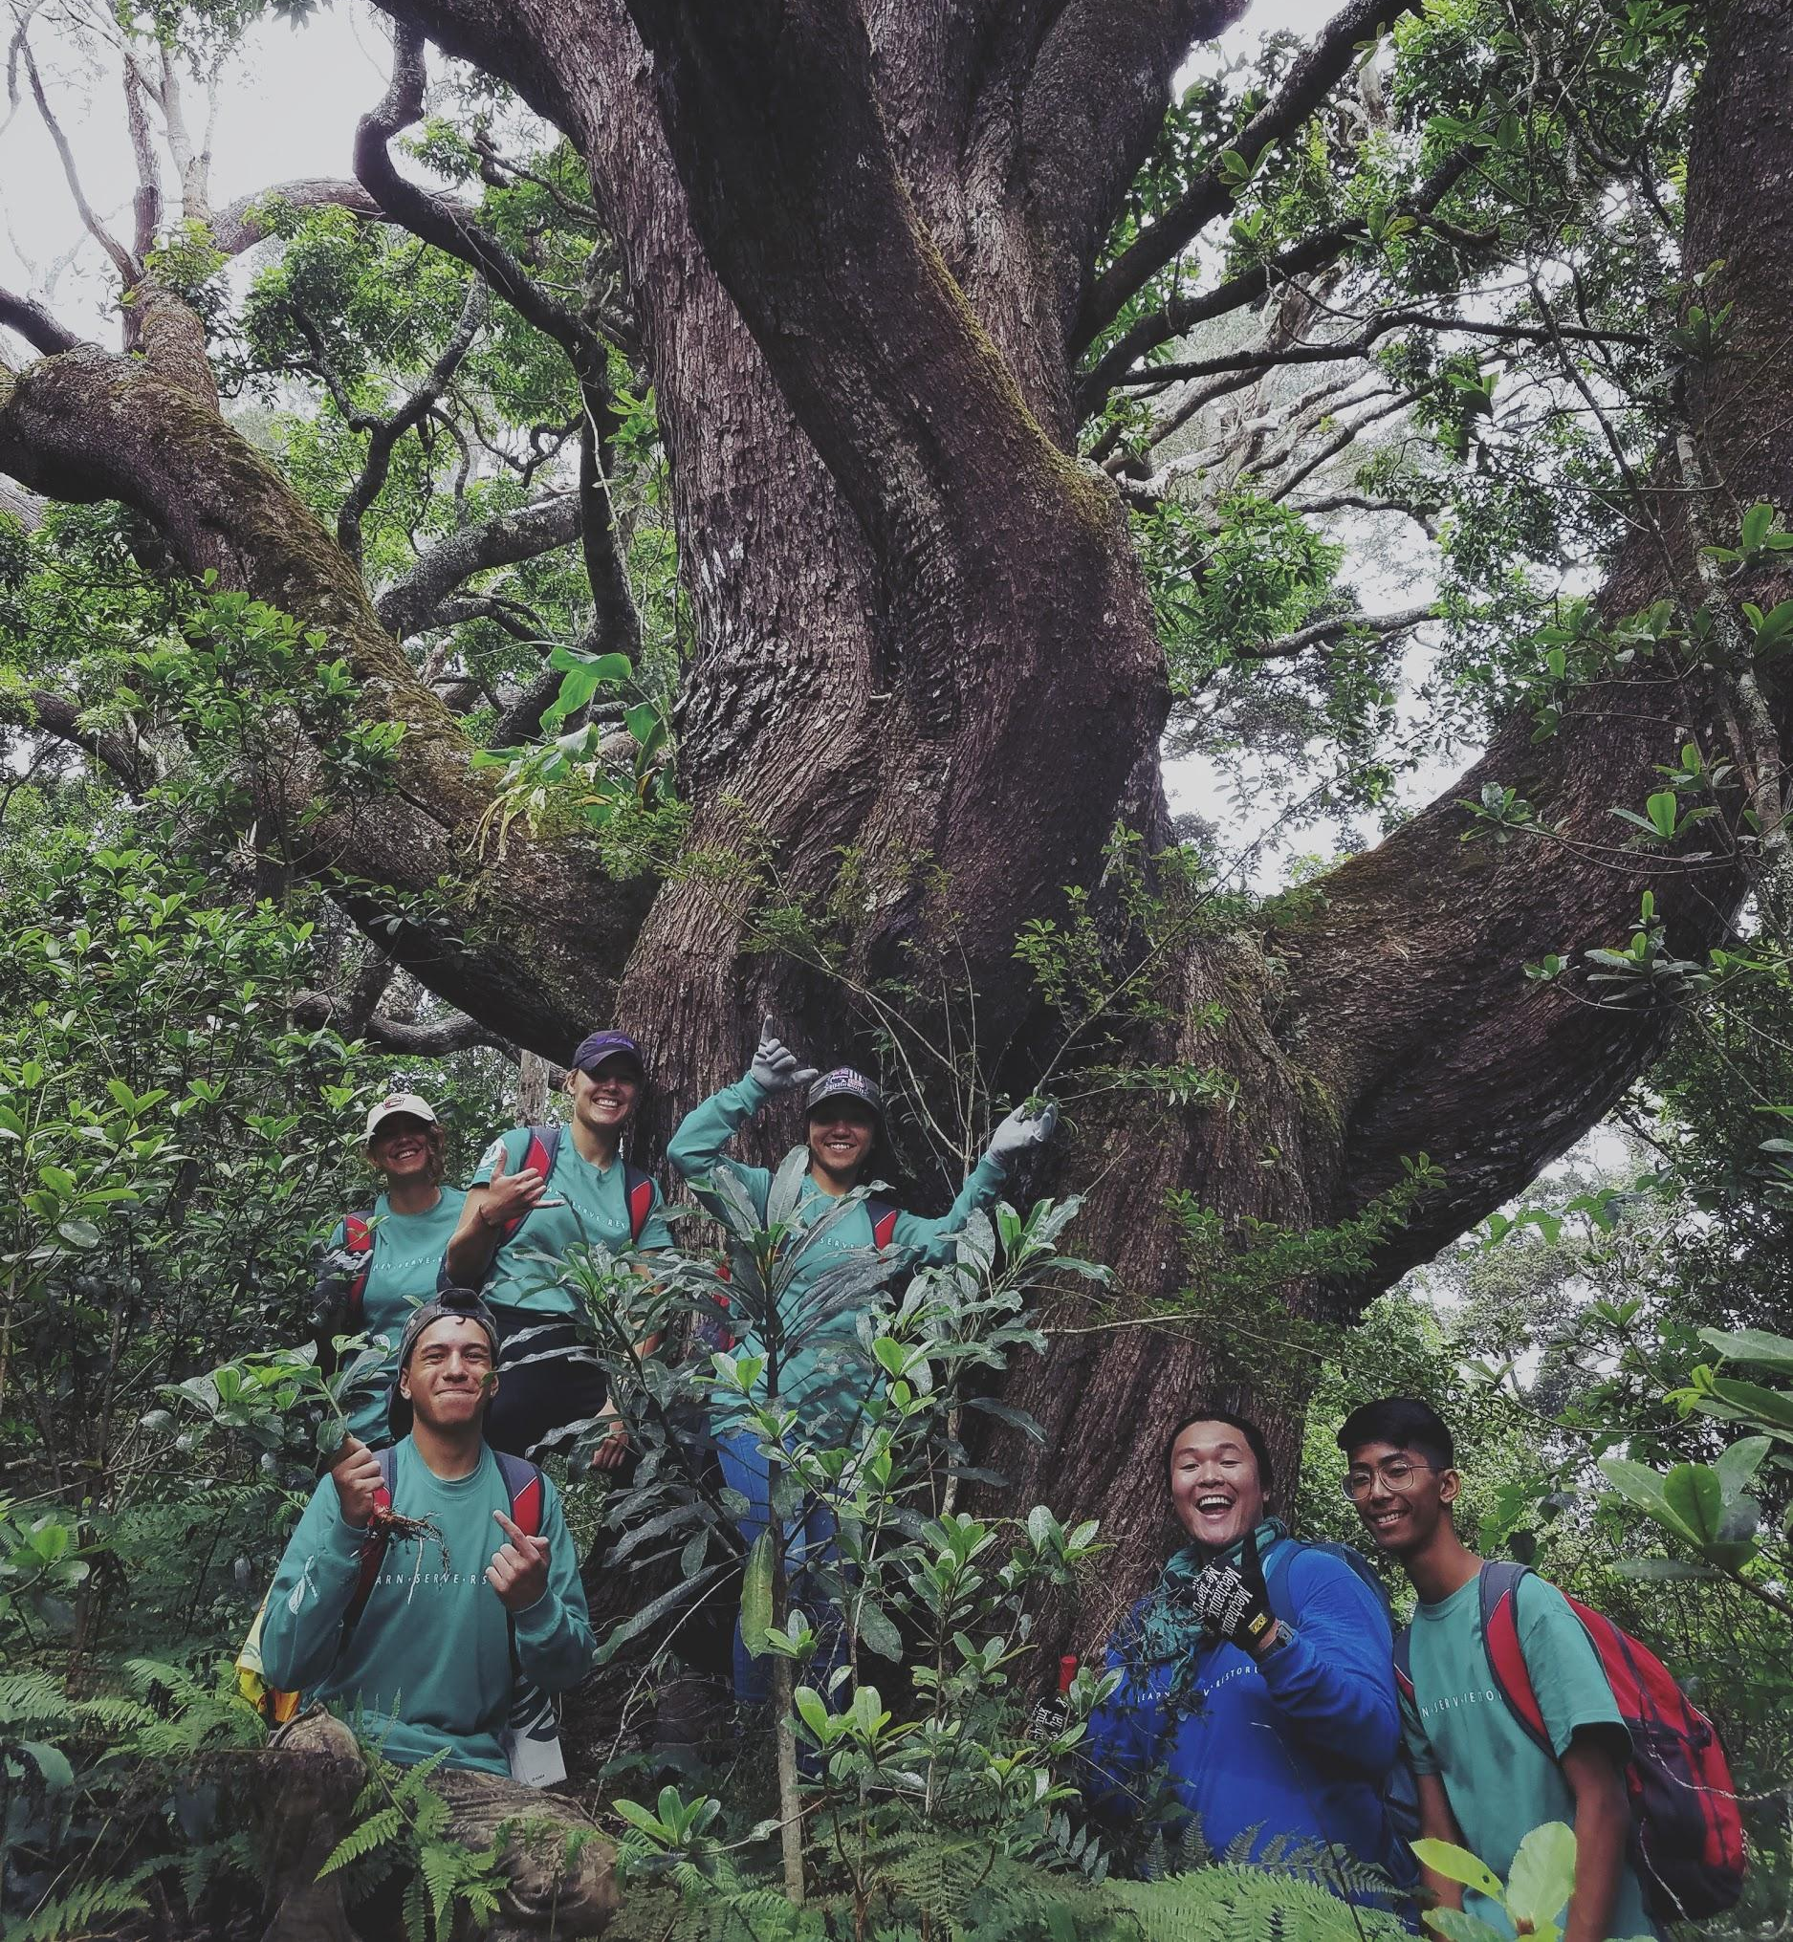
Amplifying Efforts
Kupu - 300+ young adults engage in field conservation activities
1400 other professionals in conservation
Citizen Scientists
Wannabe Scientists (like me)
Notes:
So why Kupu?
The Department of Land and Natural Resources is a relatively small department, with a limited amount
Kupu engages roughly 300+ NEW young adults in conservation every year.
Along with Kupuʻs participants, there are 1400 other professionals in the conservation field, plus many more Citizen Scientists who take an interest in native botany as a hobby.
We can empower this army of conservationists to amplify and exponentially speed up our efforts for protection by providing them a handy resource to use.

Slide 6
